Slide 1

Software Testing and Quality Assurance Project
Automated Testing for Student Grade System
Course: Software Testing and Quality Assurance (Fall 2025)
Team Members:
Ahmad Al-Dawood (202201115)
Mohammed Al-Shammasi (202201348)
Abdulhadi Al-Sultan (202201246)

Slide 2
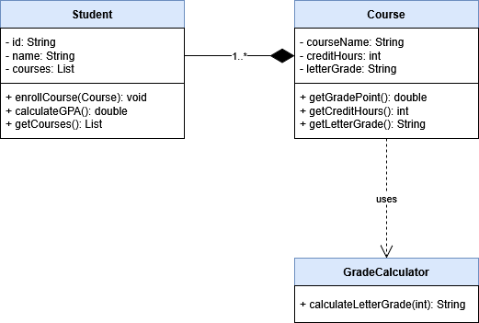
Project Abstract & Objectives
Goal: Validating the reliability of a Student Grade Calculation System (Classes: Student, Course, GradeCalculator).
Approach: Implemented a comprehensive testing plan following IEEE 829 Standards.
Scope: Functional correctness, boundary handling, and code coverage analysis.

Slide 3

System Environment & Configuration
System Environment
Hardware: Windows with 8+ GB of ram across all machines. AMD and Intel CPUs tested.
Language: Java JDK 21
IDE: Intellij
Build Tool: Maven

Slide 4

Testing Tools Framework
JUnit 5: Used for the core testing framework.
JaCoCo: Used for code coverage analysis.
Surefire 3.1: Executes the JUnit 5 test suites during the Maven build lifecycle. Also used to generate JaCoCo report.

Slide 5
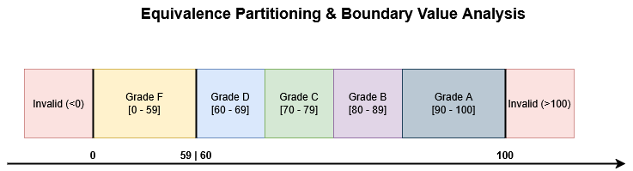
Test Case Design - Black-Box Testing
Equivalence Partitioning (EP):
Concept: Grouping inputs where the system should behave similarly.
ExampleGradeCalculator inputs 90-100 → "A", 80-89 → "B".
Boundary Value Analysis (BVA):
Concept: Testing the edges of input ranges.
Example: Testing input 89 (Boundary for B) vs. 90 (Boundary for A).

Slide 6
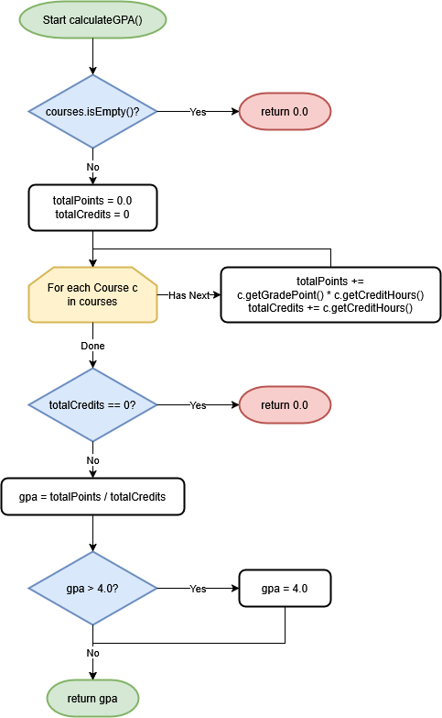
Test Case Design - White-Box Testing
Basis Path Testing:
Designed to execute every independent path through the calculateGPA method.
Decision Coverage:
Ensuring logical branches (True/False) are executed.
Example from Code:
Scenario: testCalculateGPACapped (Ensures GPA never exceeds 4.0).
Scenario: testCalculateGPAInvalidGrade (Ensures invalid grades default to F/0.0).

Slide 7
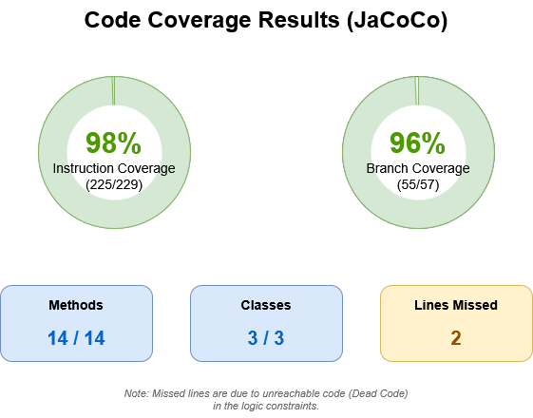
Code Coverage Analysis (JaCoCo Results)
Metrics Evaluated:
Instruction Coverage (Lines of code executed).
Branch Coverage (If/Else paths taken).
Target: Aimed for high percentage coverage

Slide 8
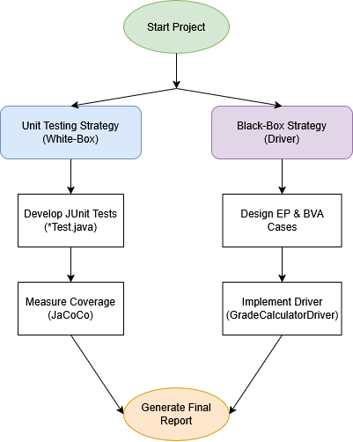
Integration Testing
Approach: Bottom-Up Integration.
Interaction: Tested the interaction between Student class and Course class.
Test Case: testCalculateGPAMultipleCourses
Input: Student enrolls in Course A (3 credits) and Course B (4 credits).
Verification: Calculated GPA matches the weighted average formula.

Slide 9
Challenges & Solutions
Environment Setup:
Challenge: Configuring JaCoCo in the IDE to generate reports correctly.
Solution: Adjusted Maven build configuration to include the JaCoCo agent.
Test case development:
Challenge: Handling "Dead Code" (Unreachable Logic).
Solution: Analyzed upstream constraints (Constructor sanitization) and documented why 100% coverage was theoretically impossible (e.g., GPA Cap check).
Challenge: Defining effective Black-Box inputs.
Solution: Utilized Boundary Value Analysis (BVA) to specifically target edge cases (e.g., 59/60, 89/90) rather than random sampling.

Slide 10
Conclusion
Successfully verified the Grade Calculation System.
Demonstrated robust handling of edge cases (Invalid grades, empty course lists).
Achieved high code coverage using industry-standard tools (JaCoCo).

